Slide 1
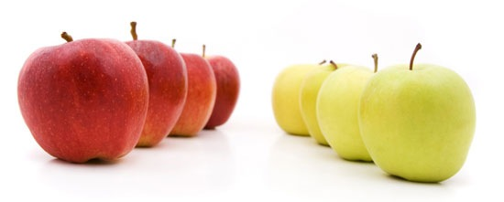
2-1B Comparisons of Equality

Slide 2
Comparisons of equality mean…
Saying that two things are equal in some way.

Slide 3
Por ejemplo,
The cat is as big as the dog.

Slide 4
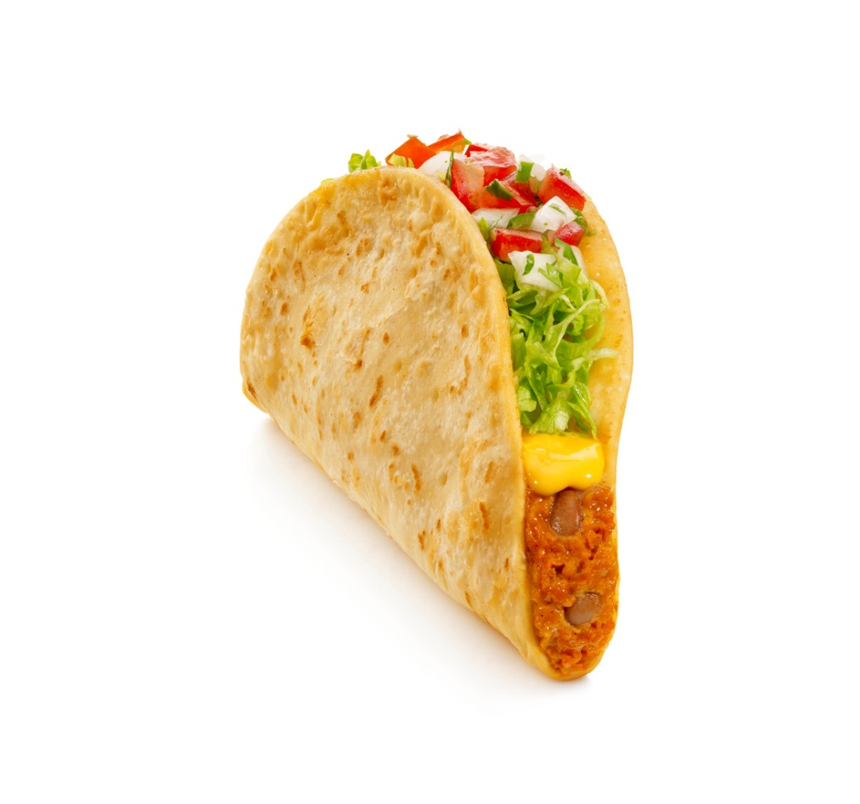

Por ejemplo,
The taco is as delicious as the sandwich.

Slide 5
Por ejemplo,
I have as many llamas as you do.

Slide 6
EQUALITY. Sí.

Slide 7
Tan + adjective + como

Slide 8
Tan + adjective + como
(tan + adj. + como) is a formula
We use it to say
(as + adjective + as)

Slide 9
The cat is as big as the dog.
El gato es tan grande como el perro.
Big or grande is the adjective.
When you’re making a comparison with an adjective, use tan.

Slide 10
Tan + adj. + como
Regardless of
number or gender,
if the comparison involves
an adjective,
use tan.

Slide 11

The taco is as delicious as the sandwich.
El taco es tan delicioso como el sándwich.
Delicious or delicioso is the adjective.
When you’re making a comparison with an adjective, use tan.

Slide 12
Tan + adjective + como
Ejemplos

Slide 13
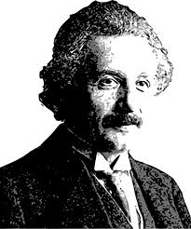
I am as intelligent as Albert Einstein.
Yo soy tan inteligente como
Albert Einstein.
Intelligent or inteligente is the adjective.
When you’re making a comparison with an adjective, use tan.

Slide 14
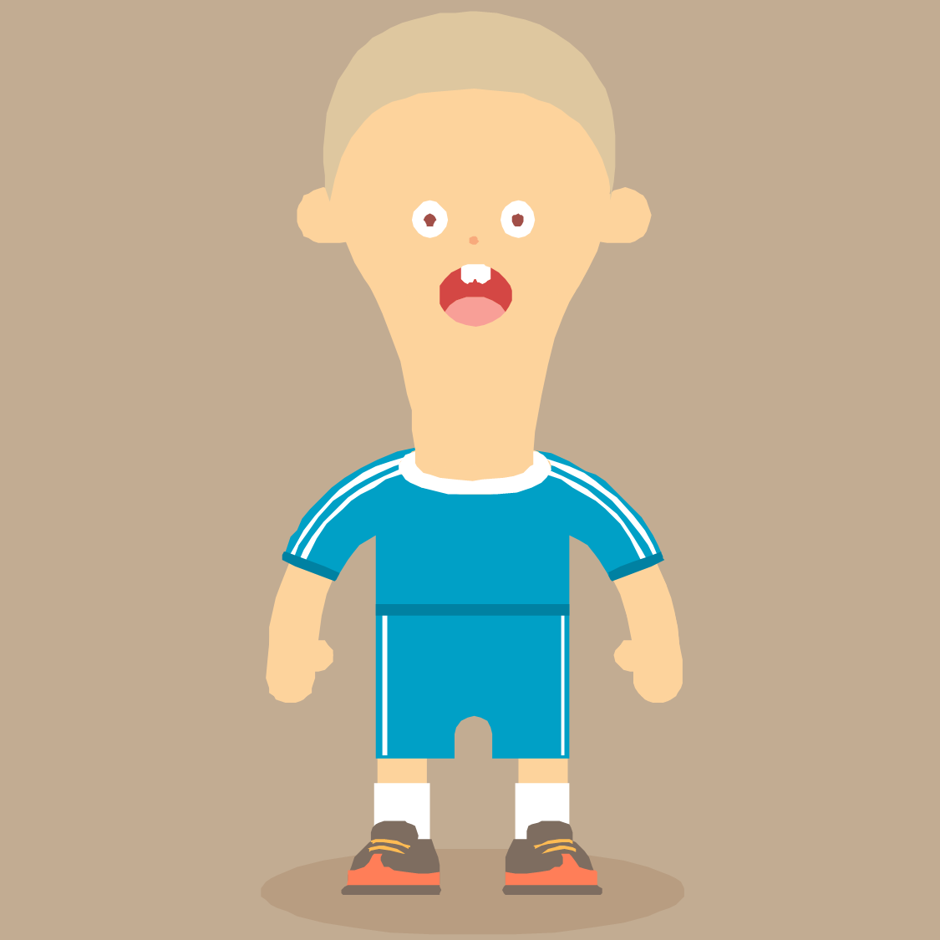
You are as confused as Pepe.
Tú eres tan confundido como Pepe.
Confused or confundido is the adjective.
When you’re making a comparison with an adjective, use tan.

Slide 15
Tan + adjective + como
¿Hay preguntas?

Slide 16
Tanto/Tanta/Tantos/Tantas + noun + como

Slide 17
Por ejemplo,
I have as many llamas as you do.

Slide 18
I have as many llamas as you do.
Yo tengo tantas llamas como tú.
Llamas or llamas is the noun.
When you’re making a comparison with a noun, use tanto/tanta/tantos/tantas.

Slide 19
Tanto/tanta/tantos/tantas
+ noun + como
If the comparison involves a noun, you change tanto/tanta/tantos/tantas depending on that noun
– not the subject!

Slide 20
Tanto/tanta/tantos/tantas
+ noun + como
The noun involved
el interés
la inteligencia
los libros
las canciones
As a comparison
Tanto interés
Tanta inteligencia
Tantos libros
Tantas canciones

Slide 21

I have as many books as she does.
Yo tengo tantos libros como ella.
Libros or books is the noun.
When you’re making a comparison with a noun, use tanto/tanta/tantos/tantas.

Slide 22
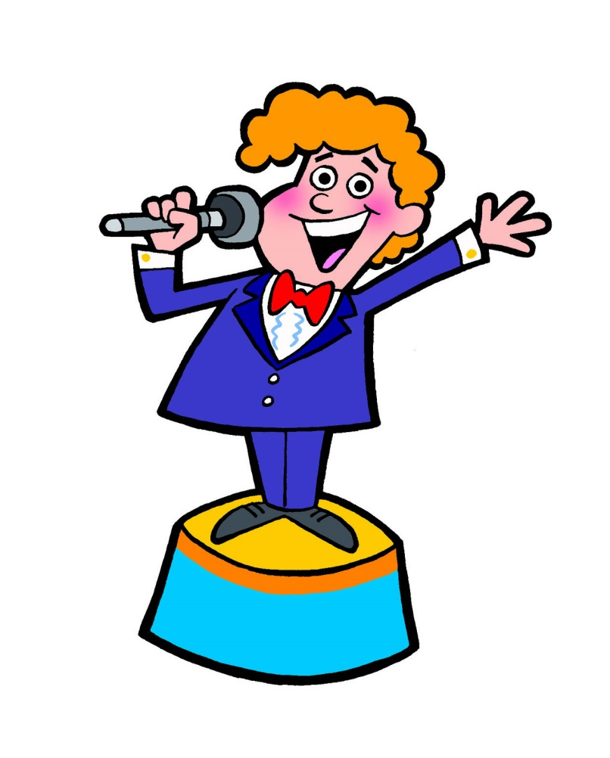
You have as much talent as I do.
Tú tienes tanto talento como yo.
Talento or talent is the noun.
When you’re making a comparison with a noun, use tanto/tanta/tantos/tantas.

Slide 23

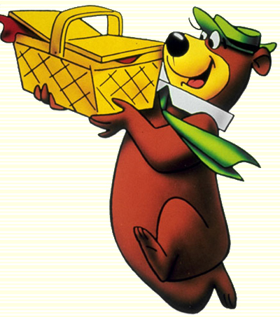
Pepe needs as much food as a bear.
Pepe necesita tanta comida como un oso.
Comida or food is the noun.
When you’re making a comparison with a noun, use tanto/tanta/tantos/tantas.

Slide 24
Tanto/Tanta/Tantos/Tantas + noun + como
¿Hay preguntas?

